Slide 1


C Programing
Prof. John Y. Chiang
Dept. of Computer Science & Engineering
National Sun Yat-sen University
chiang@cse.nsysu.edu.tw
http://image.cse.nsysu.edu.tw

Slide 2
Contents
1 C Overview
2 Selection and Decision
3 Repetition and Loops
4 Function
5 Arrays
6 Pointers I
7 Pointers II
8 Structure
9 Link list
10 Class and object
I Number system

Slide 3

Lecture 9
Link list

Slide 4

Outline
Introduction
Self-Referential Structures
Dynamic Memory Allocation
Linked Lists
Stacks
Queues
Double link list

Slide 5
Introduction
Fixed-size data structures
    Arrays, structs
Dynamic data structures
    Grow and shrink as program runs
    Linked lists
        Insert/remove items anywhere
    Stacks
        Insert/remove from top of stack
    Queus
        Like a line, insert at back, remove from front

Slide 6
Self-Referential Structures
Contains a pointer member that points to a structure of the same structure type
    struct node {
    int data;
    struct node *nextPtr;
    };
A structure of type struct node has two member
    integer member data
    pointer member nextPtr
nextPtr points to a structure of type struct node

Slide 7
Self-Referential Structures
Self-referential structure
    Link together to form useful data structures
        Lists, stacks, queues, trees
    Terminated with NULL pointer
15
10
Data member and pointer
NULL pointer (points to nothing)

Slide 8
Dynamic Memory Allocation
Dynamic memory allocation
    Obtain and release memory during program execution
    Create and remove nodes
    Functions malloc and free, and operator sizeof

Slide 9
Dynamic Memory Allocation
Memory allocation
Function malloc
    Takes as an argument the number of bytes to be allocated
    Returns a pointer of type void*(pointer to void)to the allocated memory
    Ex: newPtr=malloc(sizeof(struct node));
        Allocates a new area in memory of sizeof(struct node) bytes
        Stores a pointer to the allocated memory in variable newPtr
        If no memory is available, malloc returns a NULL pointer

Slide 10
Dynamic Memory Allocation
Function free
    delete newPtr;
    To free memory dynamically allocated by the preceding malloc call
    Ex: free( newPtr );

Slide 11
Linked Lists
Linked list
    Collection of self-referential structures (nodes) connected by pointers (links)
    Accessed using pointer to first node of list
        Subsequent nodes accessed using the links in each node
    Link in last node is null (zero)
        Indicates end of list
    Data stored dynamically
        Nodes created as necessary
        Node can have data of any type

Slide 12
Linked Lists
●
starPtr
17
●
29
●
…
93

Slide 13
Linked Lists
Linked lists vs. arrays
    Arrays can become full
        Allocating "extra" space in array wasteful, may never be used
        Linked lists can grow/shrink as needed
        Linked lists only become full when system runs out of memory
    Linked lists can be maintained in sorted order
        Insert element at proper position
        Existing elements do not need to be moved

Slide 14
Linked Lists
Create the first node
1
struct node{
int value;
struct node *nextPtr;
};
typedef node *node_point;
node_point firstPtr=NULL;
node_point newone=(node_point)malloc(sizeof(node));
newone ->value=93;
newone ->nextPtr=NULL;
*firstPtr= newone;
firstPtr
●
NULL
2
●
firstPtr
93

Slide 15
Linked Lists
Selected linked list operations
    Insert node at front
    Insert node at back
    Insert a key after some node
    Remove node from front
    Remove node from back
    Remove a key after some node
In following illustrations
    List has firstPtr and lastPtr
    (a) is before, (b) is after

Slide 16
Insert at front
a)
firstPtr
7
11
newPtr
12
b)
firstPtr
7
11
newPtr
12
firstPtr = newPtr
newPtr->nextPtr = firstPtr

Slide 17
Insert at front
node_point insert_front(int key, node_point firstPtr )
{
node_point newPtr=(node_point)malloc(sizeof(node));
newPtr ->value=key;
newPtr ->nextPtr=NULL;
newPtr->nextPtr = firstPtr;
firstPtr = newPtr;
return(firstPtr);
}

Slide 18
Insert at back
a)
firstPtr
lastPtr
newPtr
12
7
11
5
b)
firstPtr
lastPtr
newPtr
12
7
11
5
lastPtr->nextPtr = newPtr
lastPtr = newPtr
If list empty, then
firstPtr = lastPtr = newPtr

Slide 19
Insert at back
node_point insert_back( int key, node_point firstPtr, node_point lastPtr)
{
node_point newPtr=(node_point)malloc(sizeof(node));
newPtr ->value=key;
newPtr ->nextPtr=NULL;
lastPtr->nextPtr = newPtr;
if(IsEmpty(firstPtr))
firstPtr = lastPtr = newPtr;
else
lastPtr = newPtr;
return(firstPtr);
}

Slide 20
Insert at back
int IsEmpty(node_point firstPtr)
{
if(firstPtr==NULL)
return 1;
else
return 0;
}

Slide 21
Insert a key after some node
newPtr
●
●
firstPtr
firstPtr
●
●
worknode
1
key
29
29
●
17
●
17
●
●
93
93
firstPtr
worknode
newPtr
2
●
●
●
key
●
4
3
17
●
29
●
93

Slide 22
Insert a key after some node
node_point newPtr=(node_point)malloc(sizeof(node));
/*1.建立新節點*/
newPtr->data=key;
/* 2. 設定新節點的資料欄位*/
newPtr-> nextPtr=(* worknode)->nextPtr;
/* 3. 設定新節點的鏈節欄位指向worknode 原本指向的節點或NULL*/
(* worknode)->nextPtr=newPtr;
/* 4. 將worknode 指向新節點*/

Slide 23
Remove from front
a)
firstPtr
lastPtr
12
7
11
5
b)
firstPtr
lastPtr
tempPtr = firstPtr
12
12
7
11
5
firstPtr = firstPtr->next
If there are no more nodes,
firstPtr = lastPtr = 0
tempPtr
delete tempPtr

Slide 24
Remove from front
node_point remove_front(node_point firstPtr, node_point lastPtr)
{
node_point tempPtr;
tempPtr = firstPtr;
if(IsEmpty(firstPtr))
firstPtr = lastPtr = NULL;
else
firstPtr = firstPtr->next;
free(tempPtr);
return(firstPtr);
}

Slide 25
Remove from back
"Walk" list until get next-to-last node, until
currentPtr->nextPtr = lastPtr
a)
firstPtr
lastPtr
12
7
11
5
b)
firstPtr
currentPtr
lastPtr
12
7
11
5
tempPtr = lastPtr
lastPtr = currentPtr
tempPtr
delete tempPtr

Slide 26
Remove from back
node_point remove_back(node_point firstPtr, node_point lastPtr)
{
node_point currentPtr, tempPtr;
if(IsEmpty(firstPtr))
return(firstPtr);
else{
for (currentPtr = firstPtr; currentPtr->nextPtr != lastPtr ; currentPtr = currentPtr ->nextPtr );
tempPtr = lastPtr;
lastPtr = currentPtr;
free(tempPtr);
return(firstPtr);
}
}

Slide 27
Delete a key after some node
●
●
firstPtr
firstPtr
●
●
worknode
1
29
29
●
17
●
17
●
●
93
93
●
●
beforenode
(*beforenode)->next=(*worknode)->next;
/* 1. 將上一個節點的鏈節指向下一個節點 */

Slide 28
Delete a key after some node
●
●
firstPtr
firstPtr
●
●
worknode
17
17
●
●
93
2
free
93
●
●
beforenode
free(*worknode); /* 2. 釋放worknode(要刪除的節點)*/

Slide 29
Delete a key after some node
●
●
firstPtr
firstPtr
●
●
worknode
3
17
17
●
●
93
93
●
●
beforenode
*worknode=(*beforenode)->next; /* 3. 將worknode指向後來的節點*/

Slide 30
Linked Lists
Search link list
    If find the key, then return node point p
node_point search( int key, node_point list )
{
node_point p;
for ( p=list; p != NULL && key != p->value; p = p-> nextPtr );
return( p );
}
●
starPtr
p
●
17
●
29
●
…
93

Slide 31
Linked Lists
Upcoming program has the following functions
    insert
    Delete
    isEmpty
        A predicate function
    printList
        Prints the list

Slide 32
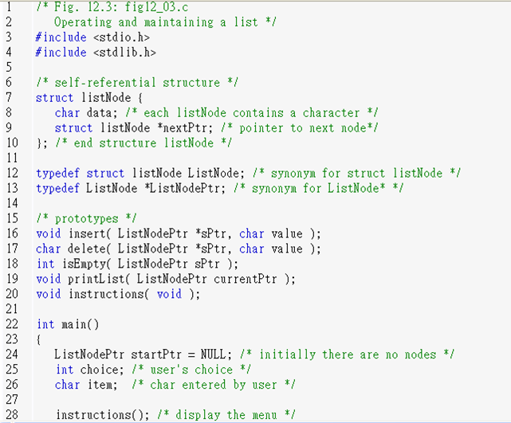
Fig12_03.c
(1 of 8)

Slide 33
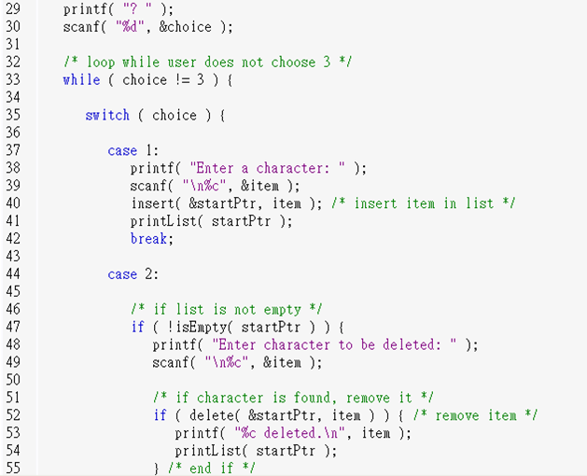
Fig12_03.c
(2 of 8)

Slide 34
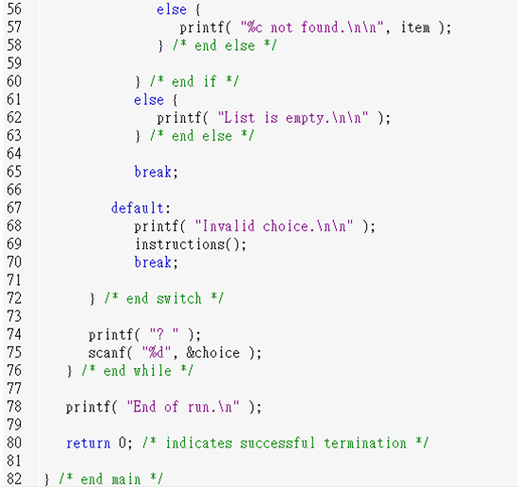
Fig12_03.c
(3 of 8)

Slide 35
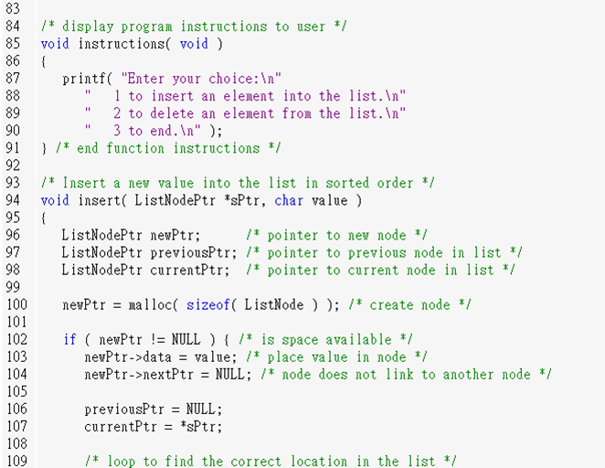
Fig12_03.c
(4 of 8)

Slide 36
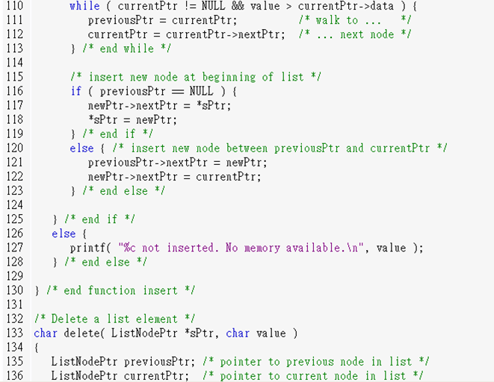
Fig12_03.c
(5 of 8)

Slide 37
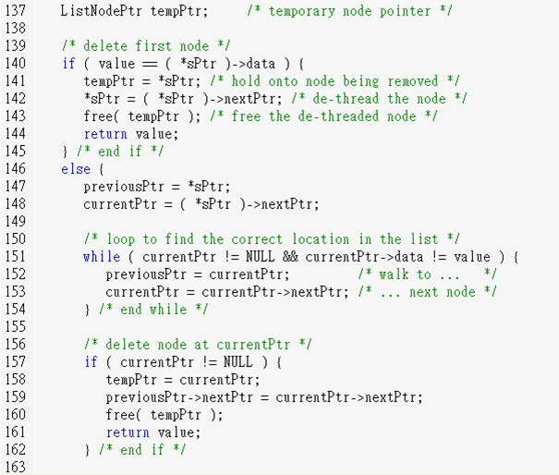
Fig12_03.c
(6 of 8)

Slide 38
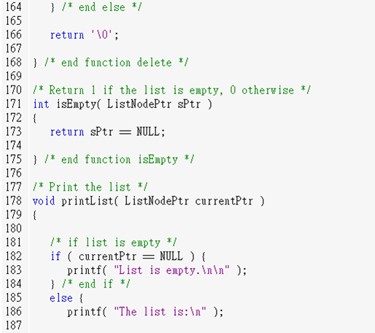
Fig12_03.c
(7 of 8)

Slide 39
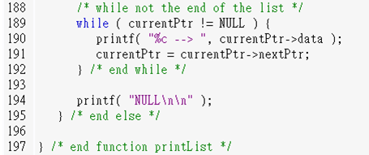
Fig12_03.c
(8 of 8)

Slide 40
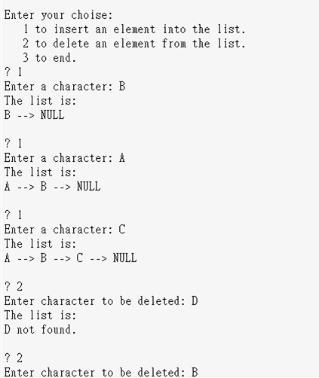
Fig12_03.c
output(1 of 2)

Slide 41
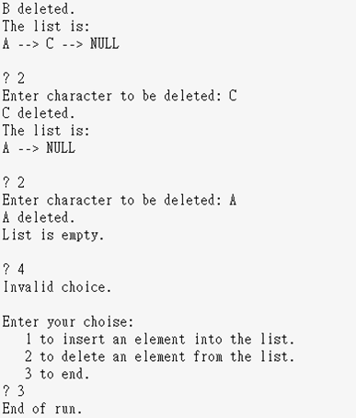
Fig12_03.c
output(2 of 2)

Slide 42
Stacks
Stack
    Nodes can be added/removed from top
        Constrained version of linked list
        Like a stack of plates
    Last-in, first-out (LIFO) data structure
    Bottom of stack has null link
Stack operations
    Push: add node to top
    Pop: remove node from top
        Stores value in reference variable

Slide 43
Stacks
Stack applications
    Function calls: know how to return to caller
        Return address pushed on stack
        Most recent function call on top
        If function A calls B which calls C:
    Used to store automatic variables
        Popped of stack when no longer needed
    Used by compilers
        Example in the exercises in book
C
B B B
A A A A A

Slide 44
Stacks
Push operation
a)
topPtr
7
11
newPtr
12
b)
topPtr
7
11
newPtr
12
firstPtr = newPtr
If list empty, then
firstPtr = lastPtr = newPtr
newPtr->nextPtr = topPtr

Slide 45
Stacks
Push
    node_point stack_insert( int key,node_point topPtr )
    {
    node_point newPtr=(node_point)malloc(sizeof(node));
    newPtr ->value=key;
    newPtr ->nextPtr=NULL;
    newPtr->nextPtr = topPtr;
    topPtr = newPtr;
    return(topPtr);
    }

Slide 46
Stacks
Pop operation
a)
topPtr
●
17
●
29
●
…
93
b)
topPtr
●
17
●
29
●
…
93
tempPtr
●
delete tempPtr

Slide 47
Stacks
Pop operation
    node_point stack_remove(node_point topPtr)
    {
    node_point tempPtr;
    tempPtr = topPtr;
    if(IsEmpty(topPtr))
    topPtr = NULL;
    else
    topPtr = topPtr->next;
    free(tempPtr);
    return(topPtr);
    }

Slide 48
Queues
Queue
    Like waiting in line
    Nodes added to back (tail), removed from front (head)
    First-in, first-out (FIFO) data structure
    Insert/remove called enqueue/dequeue
Applications
    Print spooling
        Documents wait in queue until printer available
    Packets on network
    File requests from server

Slide 49
Queues
enqueue operation
a)
headPtr
tailPtr
newPtr
12
7
11
5
b)
headPtr
tailPtr
newPtr
12
7
11
5
tailPtr = newPtr
If list empty, then
headPtr = tailPtr = newPtr

Slide 50
Queues
    node_point enqueue ( int key, node_point headPtr, node_point tailPtr)
    {
    node_point newPtr=(node_point)malloc(sizeof(node));
    newPtr ->value=key;
    newPtr ->nextPtr=NULL;
    tailPtr->nextPtr = newPtr;
    if(IsEmpty(headPtr))
    headPtr = tailPtr = newPtr;
    else
    tailPtr = newPtr;
    return(headPtr);
    }

Slide 51
Queues
dequeue operation
a)
headPtr
tailPtr
12
7
11
5
b)
headPtr
tailPtr
tempPtr = headPtr
12
12
7
11
5
headPtr = headPtr->next
If there are no more nodes,
headPtr = tailPtr = 0
tempPtr
delete tempPtr

Slide 52
Queues
    node_point dequeue(node_point headPtr, node_point tailPtr)
    {
    node_point tempPtr;
    tempPtr = headPtr;
    if(IsEmpty(headPtr))
    headPtr = tailPtr = NULL;
    else
    headPtr = headPtr->next;
    free(tempPtr);
    return(headPtr);
    }

Slide 53
Double Link List
Need twe pointers that points either to the next node or to the previous node
    Ex.
    struct node
    {
    int value;
    struct node *next;
    struct node *prev;
    }*head;

Slide 54
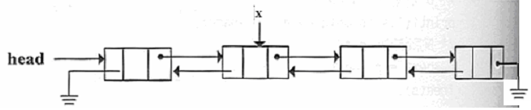
Double Link List
Double Link List
    If p is pointer of some node, then
        p=p->next->prev=p->prev->next;
    Otherwise, the double link list is empty

Slide 55
Double Link List
Create the first node
1
struct node{
int value;
struct node *next;
struct node *prev;
};
typedef node *node_point;
node_point firstPtr=NULL;
node_point newone=(node_point)malloc(sizeof(node));
newone ->value=93;
newone ->next= newone;
newone ->prev= newone;
firstPtr= newone;
firstPtr
●
NULL
2
●
firstPtr
●
93
●

Slide 56
Double Link List
Selected linked list operations
    Insert node at front
    Insert node at back
    Insert a key after some node
    Remove node from front
    Remove node from back
    Remove some x key

Slide 57
Double Link List
Insert node at front
firstPtr
●
●
93
●
26
●
P
●
5
●
firstPtr
●
●
93
●
26
●
●
5
●

Slide 58
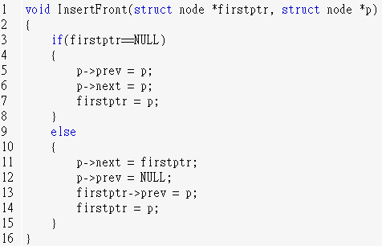
Double Link List
Insert node at front

Slide 59
Double Link List
lastPtr
Insert node at back
firstPtr
●
●
93
●
26
●
P
●
5
●
lastPtr
firstPtr
●
●
93
●
26
●
●
5
●
P

Slide 60
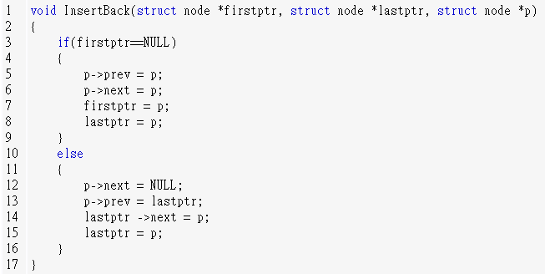
Double Link List
Insert node at back

Slide 61
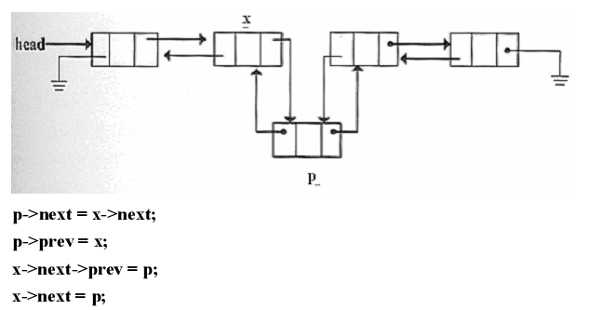
Double Link List
Insert a key after some node

Slide 62
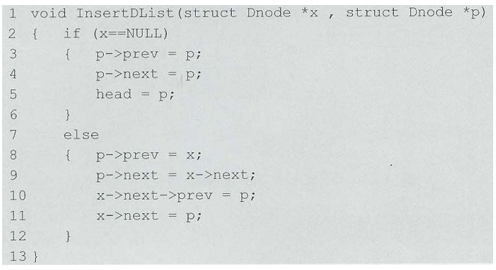
Double Link List
Insert a key after some node

Slide 63
Double Link List
Remove node at front
firstPtr
●
●
93
●
26
●
firstPtr
●
93
●
●
26
●

Slide 64
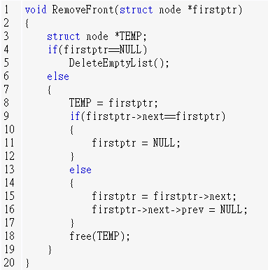
Double Link List
Remove node at front

Slide 65
Double Link List
Remove node at back
lastPtr
firstPtr
●
●
93
●
26
●
lastPtr
firstPtr
●
●
93
●
26
●

Slide 66
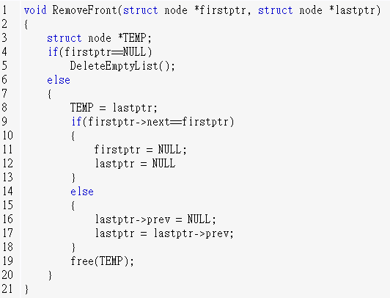
Double Link List
Remove node at back

Slide 67
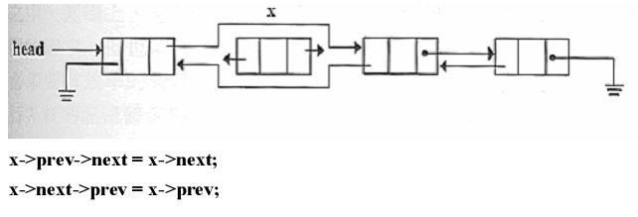
Double Link List
Remove some x key

Slide 68
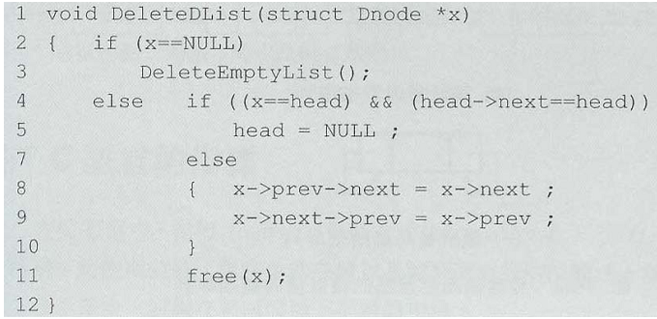
Double Link List
Remove some x key

